Slide 1

Data Lakes & Data Warehouses: Architectures for the Modern Data Era
ASDS-6305- STAT AND SCIENTIFIC COMP II
AJAY KANUMALA
VINAY DUSSA
Notes:
Today, we are going to discuss about the prominent architectures that industry uses to store/share data.

Slide 2
Why It Matters
Data is the new oil—but raw oil (data) needs to be refined and structured before use.
Businesses generate terabytes to petabytes of data daily.
Choosing the right architecture impacts.
Speed of insight.
Cost efficiency.
Scalability.
Business agility.
📈 “90% of the world’s data was created in the last two years.” – IBM
Notes:
As the saying goes – Data is the new oil

Slide 3

What is a Data Warehouse?
A centralized repository for structured, processed data.
Uses schema-on-write: structure is defined before storage.
Optimized for fast SQL queries and business intelligence.
Real-World Example:
Amazon Redshift powers dashboards at Netflix to track global content engagement.
Snowflake is used by DoorDash to aggregate order and delivery performance for real-time decisions.
Notes:
Over to Vinay

Slide 4
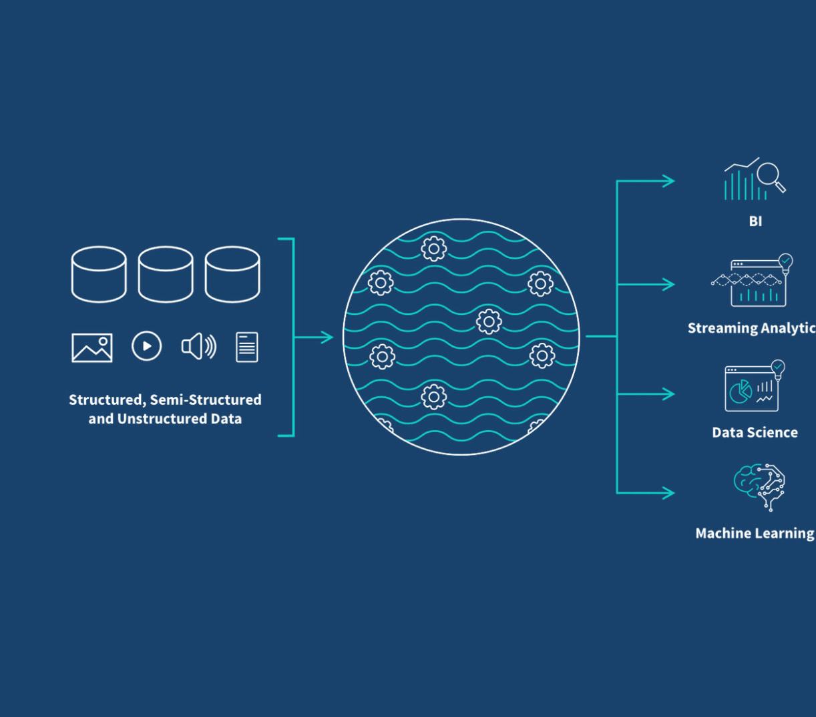
What is a Data Lake?
A storage system for raw, unstructured, and semi-structured data.
Uses schema-on-read: structure is applied when queried.
Ideal for machine learning, real-time analytics, and IoT.
Real-World Example:
Spotify uses Data Lakes to store raw audio data, user logs, and ML models.
Uber logs every app interaction into a data lake for dynamic pricing and driver routing.

Slide 5
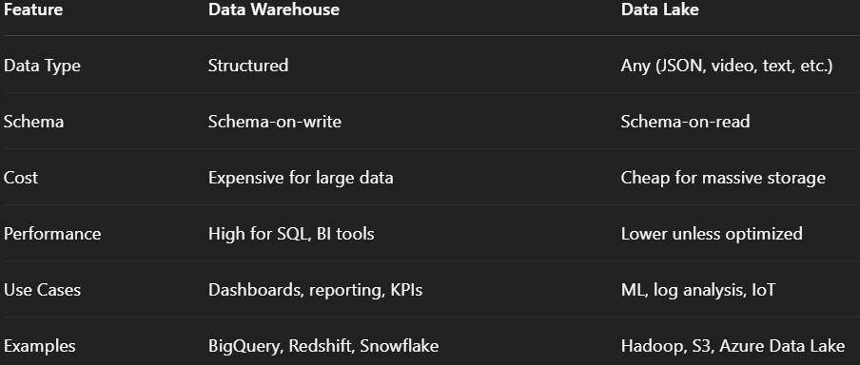
Key Differences – Comparison Table
Data Warehouse – Imagine going to a restaurant and ordering a meal from the pre-defined (structured) menu.
Data Lake – Similar to storing all the groceries in a kitchen-pantry and cooking a meal with only what you want.

Slide 6
When to Use What?
Use a Data Warehouse when:
You need fast analytics for known, structured data.
Dashboards and reporting are mission-critical.
Use a Data Lake when:
You want to store everything and decide later.
You work with ML models or raw user/event data.
Hybrid Trend:
☁️ Many organizations are now adopting Lake-houses (e.g., Databricks, Snowflake on Iceberg) for unified storage.

Slide 7
Modern Tools in the Ecosystem
Data Warehouses:
Snowflake: cross-cloud, pay-per-query
Amazon Redshift: scalable & integrated with AWS
Google BigQuery: serverless, AI-ready
Data Lakes:
Apache Hadoop: early standard, now legacy
Amazon S3 + Athena: query raw data on the cloud
Databricks Lakehouse: combines both models

Slide 8
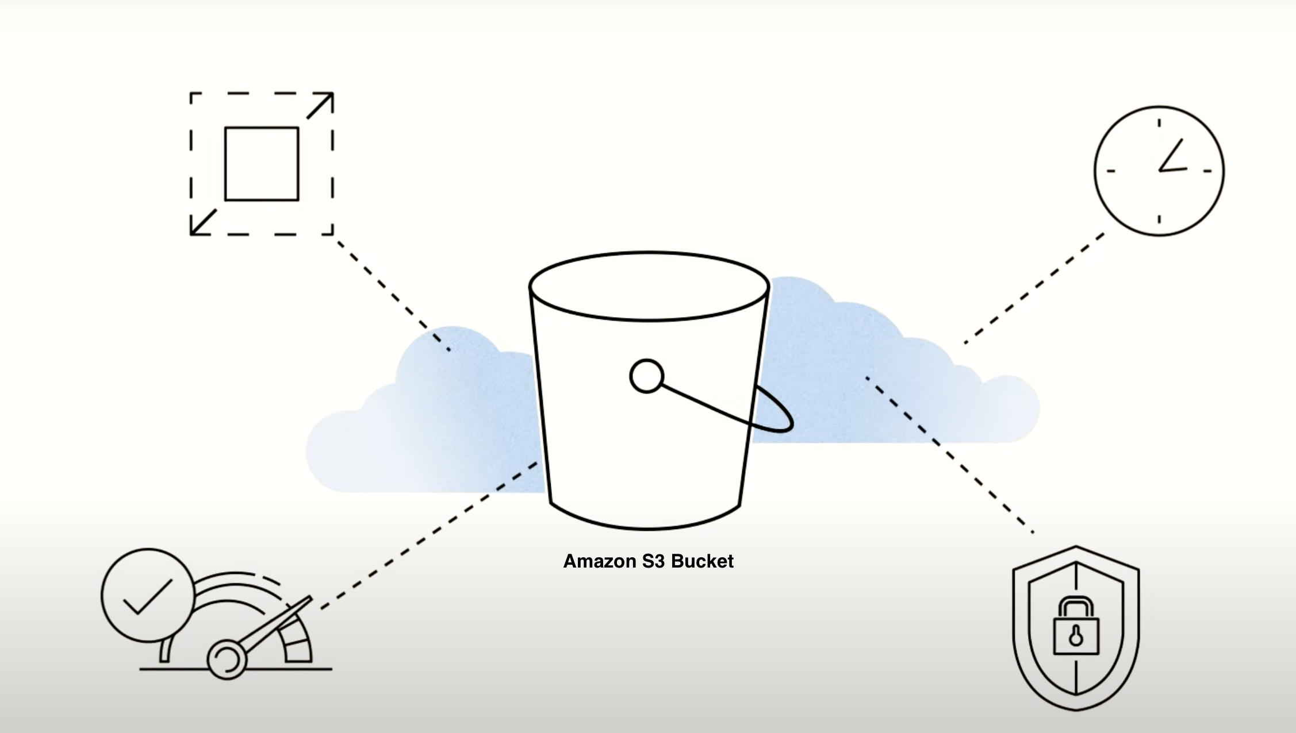
SAMPLE DEMO WITH AWS S3 & SQLite

Slide 9
Technical Aspects - Overview
Data source
Raw
Unstructured
Data Lake integration (AWS S3)
Create an AWS account
Setup an S3 bucket
Configure IAM user credentials & access
ETL pipeline
Extract: Download data from S3
Transform: Structure the data
Load: Store in SQLite (Data warehouse)
Data Warehouse integration (SQLite)
Download DB Browser or use SQLite CLI
Reporting: Use SQL commands/visualizations
Notes:
Discuss about the AWS set up process.
Show the python code used to integrate.
Talk about boto and SQLite.

Slide 10
Getting started
Some useful links
Setup - AWS S3 Bucket Setup
Source code - GitHub Repo

Slide 11
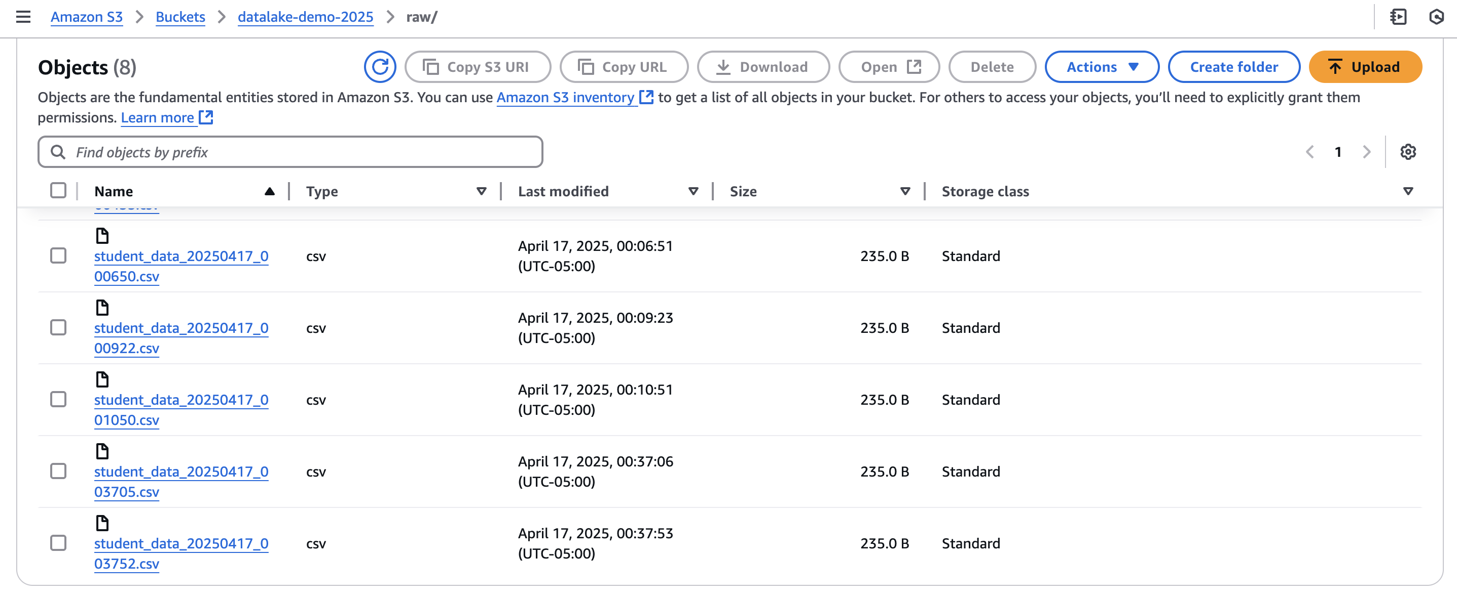
How it Looks – AWS S3

Slide 12
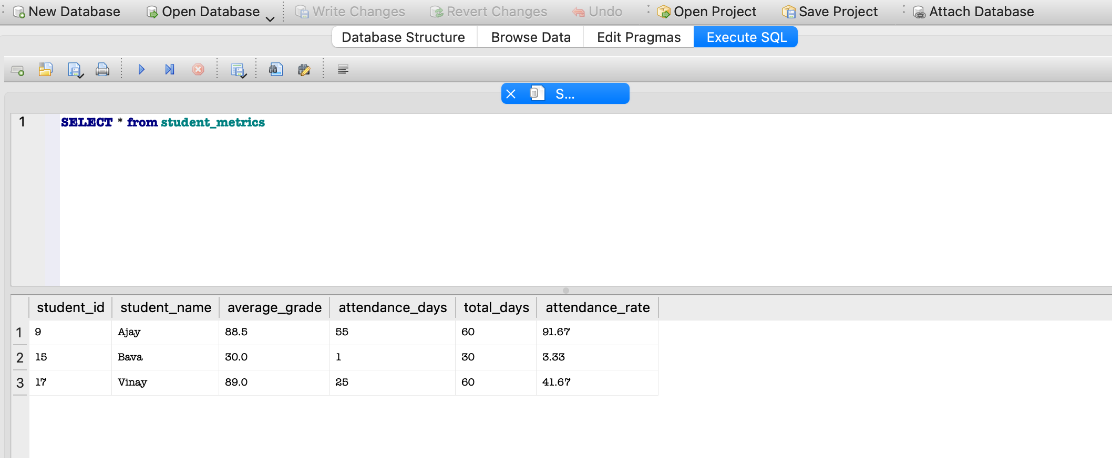
How it Looks – DB Browser(SQLITE)

Slide 13
Challenges to Consider
Data Lakes:
Easily become “Data Swamps” without governance
Security and access control are harder
Data Warehouses:
Require extensive data modeling up front
Expensive to scale with large, diverse data types

Slide 14
Real-World Use Cases
Netflix: Uses a mix of Data Lakes and Warehouses to support 200M+ global viewers.
Spotify: Streams user interactions into a lake, then runs ML for recommendations.
Walmart: Uses data warehousing to optimize inventory and supplier chains.
NASA: Stores satellite and telemetry data in data lakes for future ML analysis.

Slide 15
Future TRENDS
Rise of Lakehouse architectures (Databricks Delta, Apache Iceberg)
Integration of real-time streaming into both lakes and warehouses
AI/ML at scale made easier through raw data storage
🔮 “By 2026, 70% of organizations will move to cloud-first data architectures.” – Gartner

Slide 16
Takeaways
Understand data maturity and use case before choosing.
Data Warehouses = insight today ➡️ ordering a dish in a fancy restaurant 🍽️
Data Lakes = innovation tomorrow ➡️ stocking up your pantry for future meal prep 🥣
The future is hybrid.

Slide 17
Thank you
Open for questions!

